Slide 1
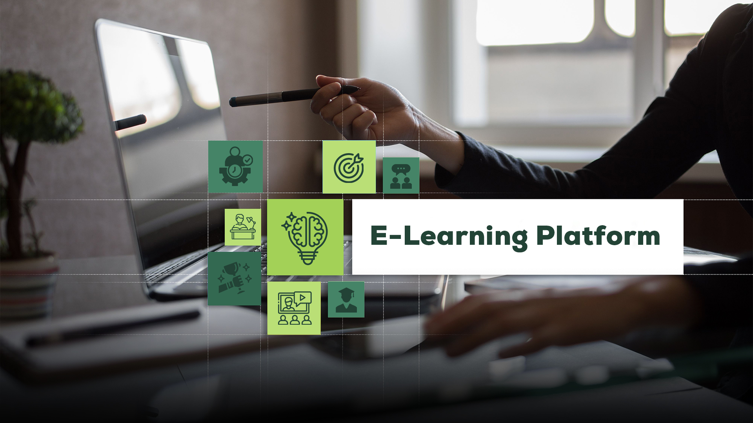
ABDUR RAZZAK
2221081081

Slide 2
Introduction
Objective
Problem Statement
Diagrams
4
Outline-
Use Case Diagrams
Class Diagrams
YOUR TITLE
Activity Diagrams
Sequence Diagrams
Conclusion
Reference

Slide 3
Introduction -
What is e-learning platform?
An e-learning platform is a virtual environment that provide various educational content or resources over the internet and student receives these services at home.
My platform, which is designed to satisfy the various demands of students worldwide. It is an innovative combination of educational knowledge and state-of-the-art technology.
My platform offers an extensive set of tools and resources to support student’s learning journey.

Slide 4
Features -
Interactive Learning Modules.
Flexible Accessibility.
2
3
4
1
Personalized Learning Paths.
Expert Instruction and Support.

Slide 5




Objectives -
To Expand Access
To Provide Flexibility
To Provide Support
and Guidance
To Evaluate and
Improve

Slide 6
Problem
Statement -
Now a days, In traditional educational systems face numerous challenges are:
Geographical Barriers.
Problem1
Problem2
Resource Limitations.
Inflexible Learning Environments.
Problem3
Problem4
Limited Accessibility for Diverse Learners.

Slide 7
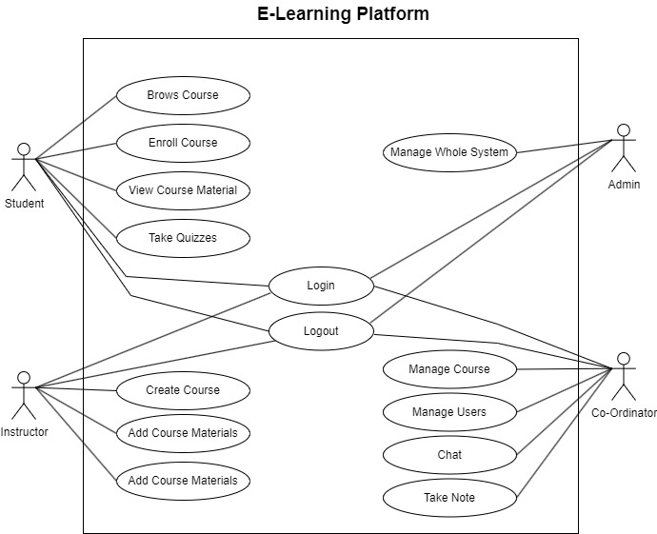
Use Case
Diagram-

Slide 8
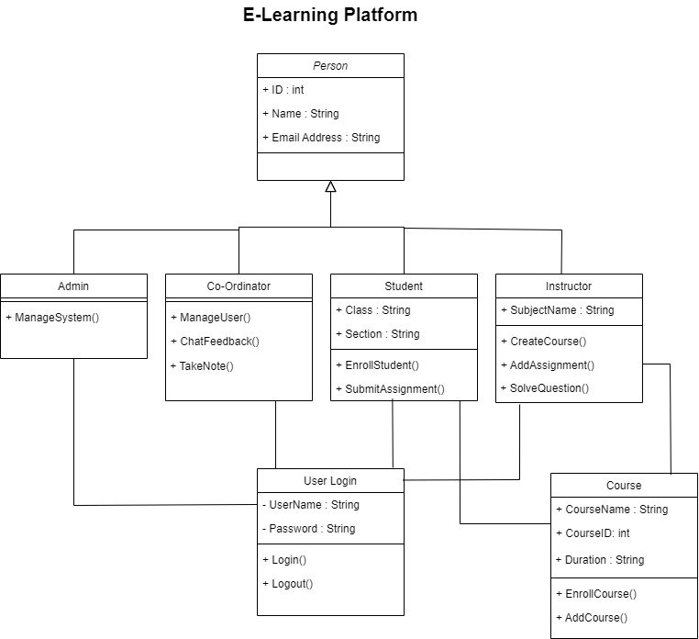
Class
Diagram-

Slide 9
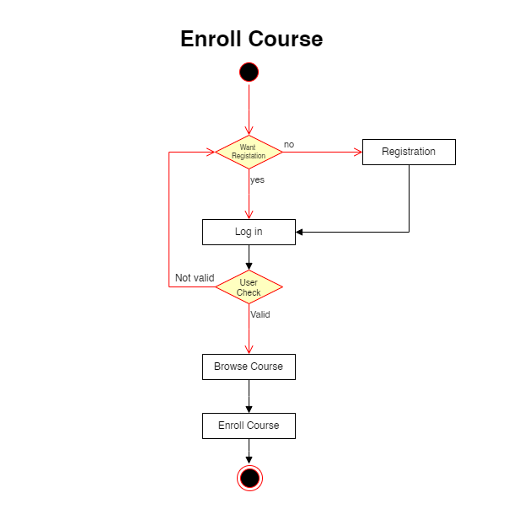
Activity
Diagram-

Slide 10
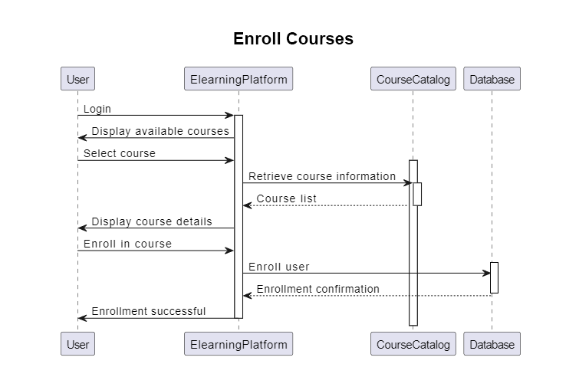
Sequence
Diagram-

Slide 11
Conclusion -
Now a day student face several problem in traditional education system, but this platform can solve the problem.

Slide 12
Conclusion -
thanks
Basically, I find the problems of traditional learning system and create a system, there every students can learn from everywhere.

